Slide 1

Design of Non-Volatile Latch using Resistive Memory Technology
ADVISOR: Dr. HAMID MAHMOODI
GROUP MENTOR: ALIYAR ATTARAN
MEMBERS: VLADISLAV MIFTAKHOV CODY DEL PRATO
SØREN TORNØE KWAN LIM
School of Engineering
San Francisco State University, San Francisco, CA
August 2017

Slide 2
Overview
Motivation
Review of Precharge Latch and Research Goals
Write Operation Monte Carlo Results
Optimization of Read Operation
Read Operation Monte Carlo Results
Comparison with Alternate Design
Layout
Post-Layout Results
Conclusion

Slide 3
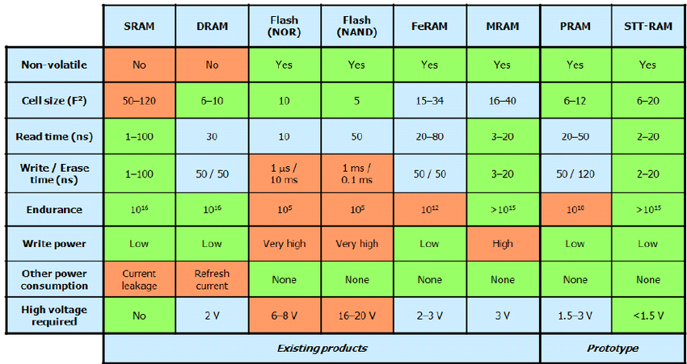
Motivation
Modern Semiconductor industry vulnerable to IP fraud and reverse engineering
STT technology can be used to improve hardware security by implementing fast, reconfigurable logic to IC design
Figure 1: Table Comparing Characteristics of various Memory Technologies
STTRAM has the potential of combining benefits of various existing memory technologies
Notes:
Modern Semiconductor industry is vulnerable to IP fraud and reverse engineering due to low hardware security and trend of IC fabrication foundries being separated from semiconductor design companies. STT technology poses as a great potential solution. It can be used to improve hardware security by implementing fast, reconfigurable logic to IC design. STTRAM has the potential of combining the benefits of various existing memory technologies while eliminating the disadvantages.

Slide 4
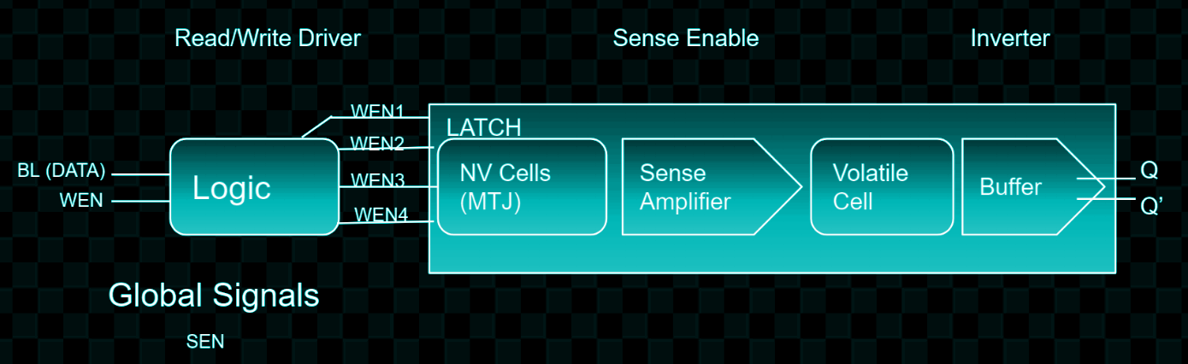
Non-Volatile (NV) Precharge latch
Logic simplifies inputting signals for read and write operations.
WRITE
Write Driver Signal from WEN causes MTJ/NV Cell state to be overwritten
MTJ state changed to match BL data entered.
READ
Sense Amplifier receives signal from Global Signals SEN
Based on state of non-volatile cell, Sense Amplifier sets the state of the volatile cell; outputs Q and Q’
Figure 2: PreCharge Latch Flow Chart Diagram
Notes:
A Precharge Latch is referred to as a resistive memory system and is non volatile by nature making it more stable than traditional RAM. We use the two MTJs as resistive memory cells to hold our data as binary one or zero. For read, there is the input, SEN, and two outputs for this circuit. The outputs are the voltage out referenced as Q for the left side of the circuit and Q’ for the right side of the circuit. For write, there are four inputs; WEN1, WEN2, WEN3, and WEN4. There is also a constant VDD connected to all pmos in the circuit.

Slide 5
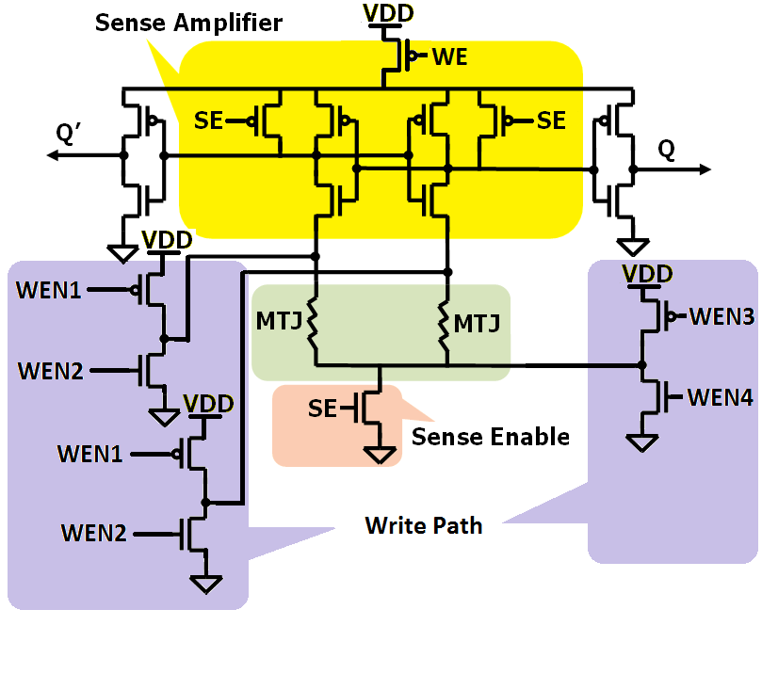




Precharge Latch
Schematic
SENSE AMPLIFIER/ READ TRANSISTORS
WRITE TRANSISTORS
MTJs
SENSE ENABLE
Notes:
The main difficulty in using a latch (resistive) is that a small charge needs to be applied, but a dc current could create potential leakage. The fact that we will be continuously reading from this makes this risky, and that is where the Precharge Latch comes into play. In the Precharge Latch, a voltage accumulates in the read stage that ultimately is discharged. The inverters are flipped and then optimization comes into play for reliability. With a low delay, chances are that process variations will be absorbed better. Right after power-up, the sense enable signal (GSE) needs to switch from high to low, while write enable (WEN) is low.

Slide 6
Research Goals
Sweep Individual Transistors in Full Latch
Sweep Full Write Cycle
Write Cycle Optimization
Write Cycle Failure Rate Simulations
Sweep, Optimize, Simulate Read Cycle
Latch Layout

Slide 7
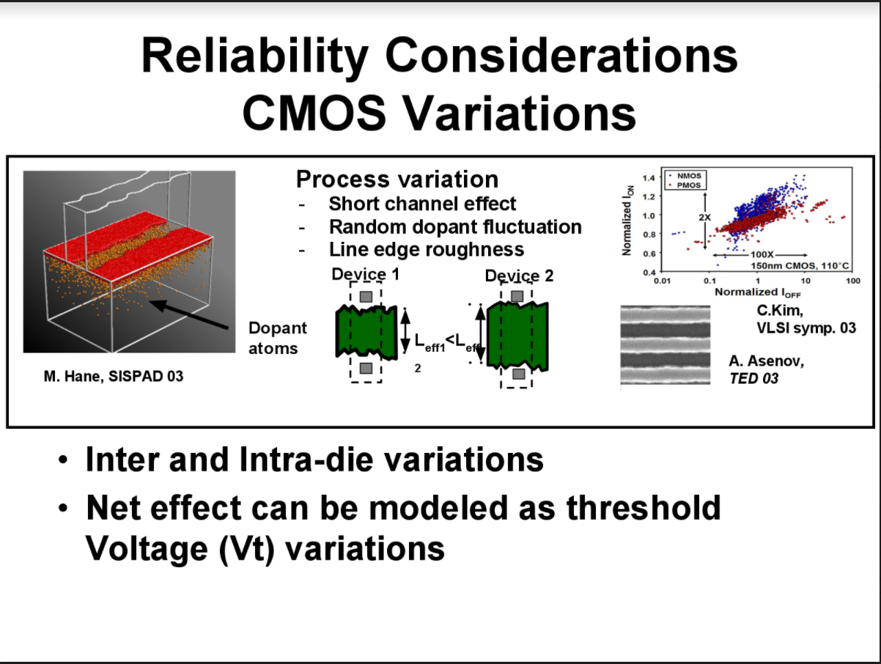
Monte Carlo
Figure 4: Reliability Considerations and CMOS Process Variations
A statistical simulation that utilizes gaussian distribution to test the real world process variations that arise during manufacturing.
Notes:
because of process variations, the transistors will not have the exact width and length that we intended. also the MTJs will not the same dimension, radius and oxide thickness as designed. Because of these variations, some of them will lead to failure or MTJs not flipping. we can count how many of these failed cases we have out of 100 or 1000 runs.
We modeled these random variances and applied them to each transistor and MTJ, creating these parameters in form of gaussian distribution. and run the netlist for 100 and 1000 times. in every run, the netlist will choose one random point in that gaussian distribution and simulate, then we add all the failed cases out of 100 or 1000 and that is the failure rate.

Slide 8
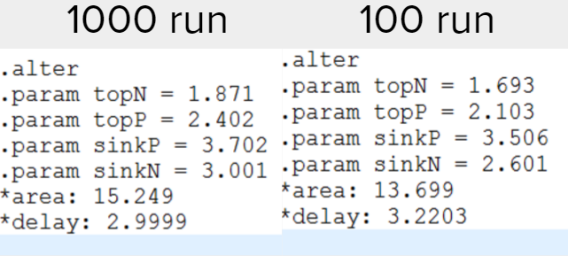
Write Operation Results
The Monte Carlo failure rate netlist program was used to test each set of values at 100 and 1000 iteration runs to ensure reliability of the circuit to within 1% and 0.1% accuracy respectively
Looked for values that passed the simulation with 0% failure rate. Write path transistors consistently large and less sensitive than Read path
Used the 1000 run result widths of write path transistors for necessary initial values in Read Simulations and Optimization
Figure 5: Optimal Monte Carlo Results for 1000 and 100 iteration runs
Notes:
The best transistor values for the write circuit were 1.871, 2.402, 3.702, and 3.001 micrometers for topN, topP, sinkP, and sinkN respectively. The highest delay for the circuit at these values was 2.9999 nanoseconds. These values were subsequently inputted into the circuit netlist as constants to now optimize the Read operation.

Slide 9

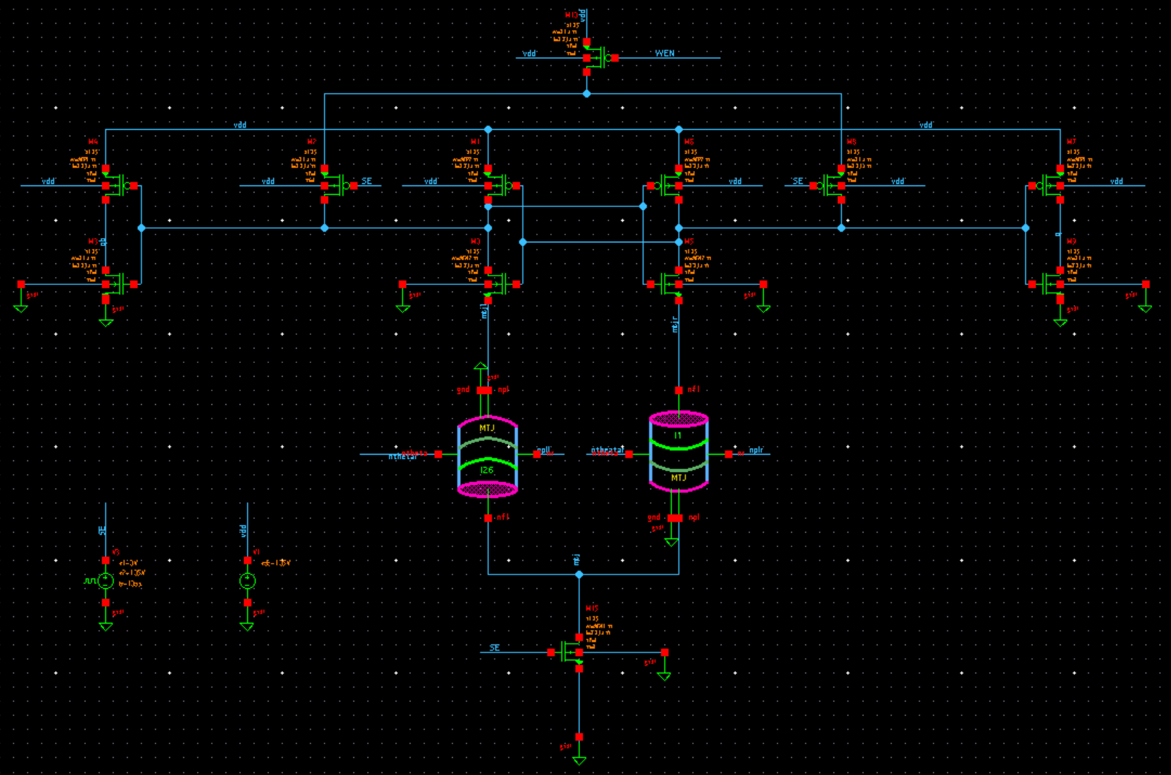



Isolated Read Operation Variables
WP2
WP2
Buffer Inverter
WP1
WN2
VDD Pmos
Latch-ception
Ground Nmos
WN1
Figure 6: Read Operation Schematic
Notes:
The read cycle consisted of 12 transistors and it was necessary to optimize each of them in order to obtain the smallest possible area for the latch. The previous testing of each individual transistor revealed that the VDD PMOS transistors in the sense amplifier and the very top VDD pmos did not need to be optimized and thus were left at the minimum size of 0.1 micrometers. Because of this and the symmetry of the left and right side of the sense amplifier, the total number of variables that were left to simulate dropped to four. The four variables were named WN1, WN2, WP1, and WP2. WN1 represented the ground nmos m15 transistor, WN2 represented the symmetric inner latch nmos m0 and m5 transistors, WP1 represented the symmetric inner latch pmos m1 and m6 transistors, and WP2 represented the m4 and m7 output buffer transistors.

Slide 10
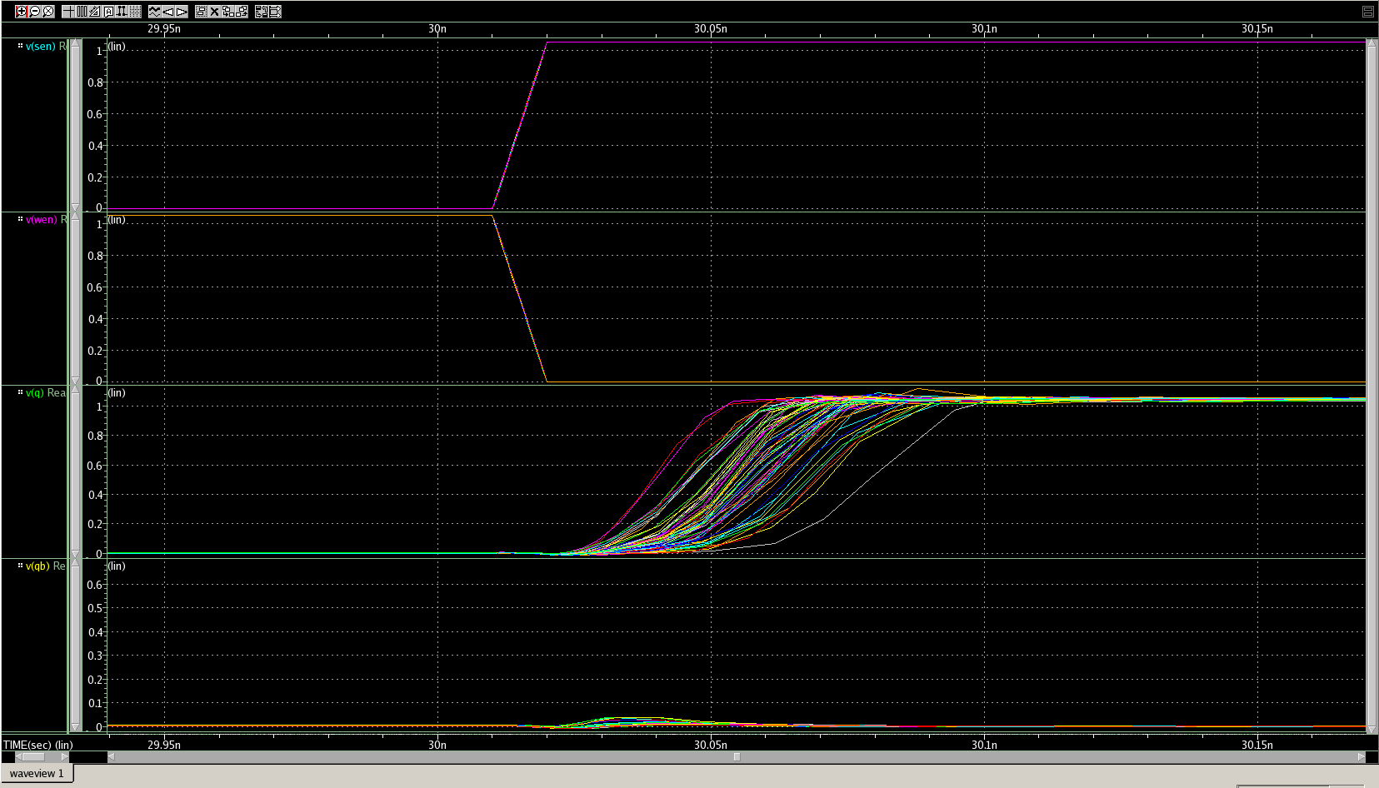
Multivariable Simulations of Read Cycle
SEN Signal
WEN Signal
Q
Q’
DELAY
Time (s)
Figure 7: Hspice Graph of Delay in Read Operation Simulations
Notes:
We constructed the multivariable netlist for the Read operation simulations in the same way we constructed the Write operation netlist, reusing much of the code. We then ran a few hundred multivariable simulations and discovered that the buffer pmos transistors were also able to operate at the minimal size value of 0.1 micrometers. This fact allowed the optimization to be further simplified to three variables. In the next series of sweep simulations, we left the buffer pmos transistors, m3 and m9, at minimum size and only varied the widths of the remaining three transistors. This allowed us to increase our sweeping resolution to less than .1 micrometers.

Slide 11
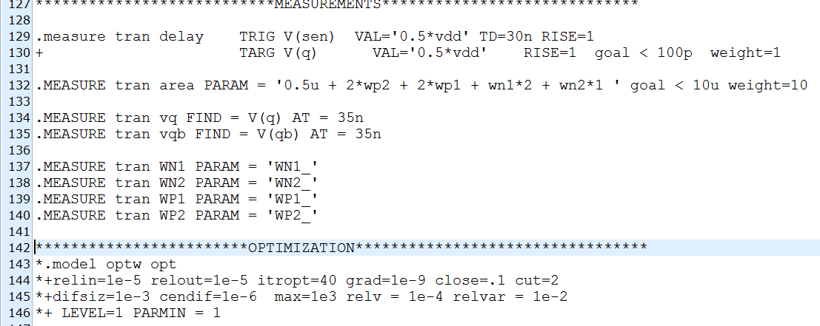
Delay and Area Optimization of Read Cycle
Used Star-Hspice optimization
Close width values from the multivariable simulations inputted
Initial goals: less than 100p delay and less than 10u area.
Figure 8: Read Operation Optimization Netlist
Notes:
Optimization of the read cycle was performed by using HSPICE and a netlist that allowed delay and area to be used as weighted goals. The netlist contained a parameter which allowed an area goal to be set so that HSpice would determine the best possible transistor sizes based on that area and weight. The initial goals used were 100 picoseconds for the delay constraint and 10 micrometers for the area constraint. The initial weight for the area was set at around 50 and the resulting areas tended to be around 22μm with the largest area measured as 34.05 μm. Once the weight was changed to 100 the areas decreased sharply to around 4um with the smallest area measured as 2.52μm. The goal for delay was decreased gradually to 50 picoseconds and then left constant. The goal for area was decreased until the program failed to find a solution, which was anything below 2.5 micrometers. In total there were about 70 sets of transistor values generated.

Slide 12
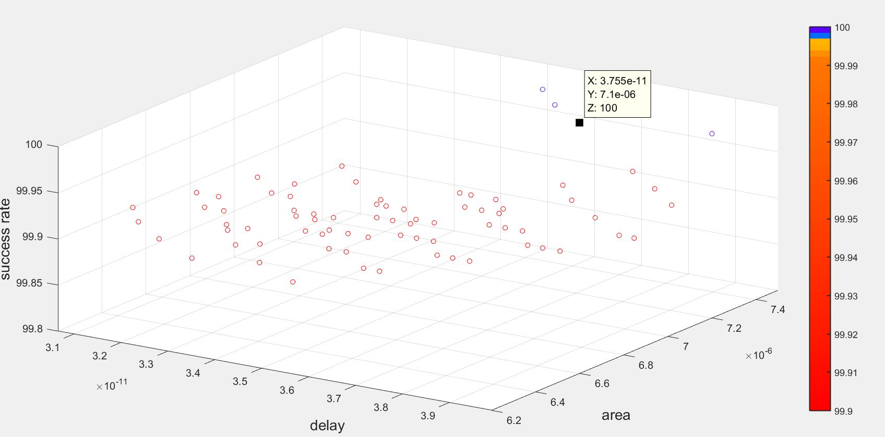

Monte Carlo Failure Rate Simulations
100 and 1000 iteration runs were performed on the 70 sets of values generated by the optimization process. Perl script outputted failure rate.
Figure 9: MATLAB Graph of Success Rate vs Delay vs Area 3D View for Read Operation
Notes:
The Monte Carlo simulations were initially run with 100 simulations on each set of transistor values that were generated from the optimization netlist. If any of the transistor sets did not achieve 100% success, the data was recorded but the values were determined to be unusable for further simulations. The transistor values which reached 100% success were then run through the simulation again but with 1000 simulations. The majority of the transistor values failed to reach 100% success, but all of the remaining values achieved above 99.7% success rate, which meant our initial multivariable sweeps were accurate.

Slide 13
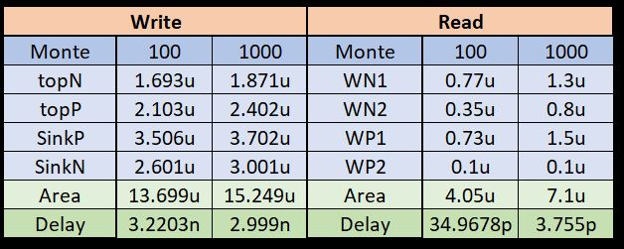
Results
Figure 10: Table of Optimal Results for Write and Read Operations

Slide 14
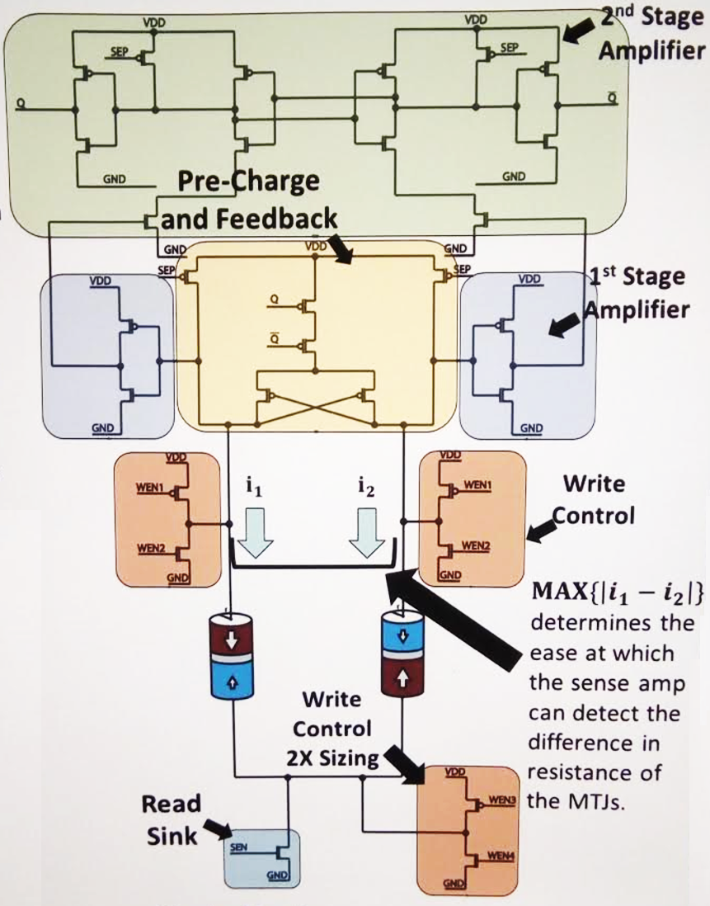
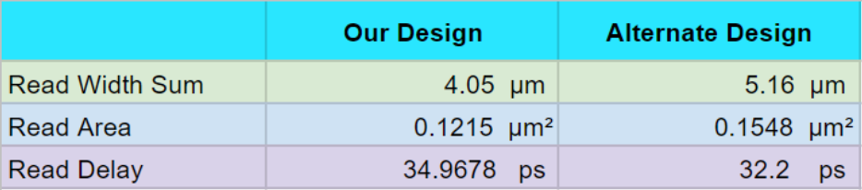
Pre-Layout Comparison with Alternate Design
Alternate design: Separated Precharge Sense Amplifier (SPCSA) with feedback
Write path area and delay identical to competing design
Figure 11: Table Comparing Read Data of our Design vs Competing Design
Figure 12: SPCSA

Slide 15
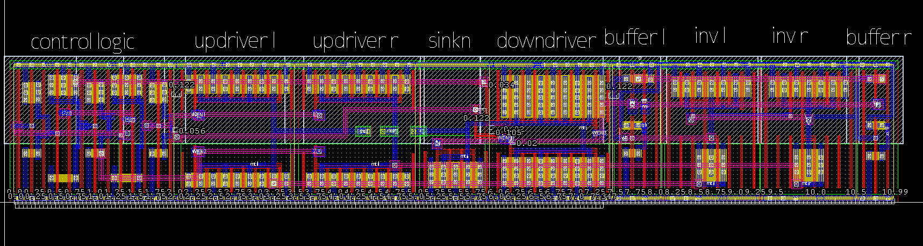
Layout
Physical layout of the circuit
Layout was broken down into parts for ease of construction
Design Rules Checking test (DRC)
Layout Versus Schematic test (LVS)
Layout Parameter Extraction test (LPE)
Figure 13: Hspice Full Latch Layout at Optimal Area

Slide 16
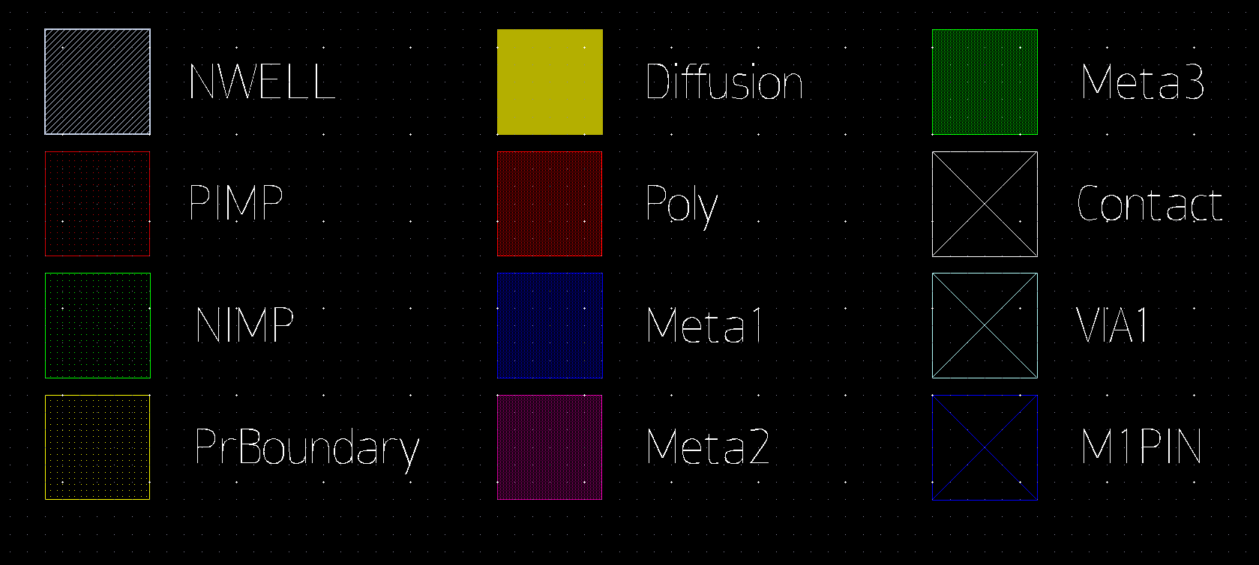
Layout: Materials for Design
Figure 14: Hspice Layout Materials Legend

Slide 17
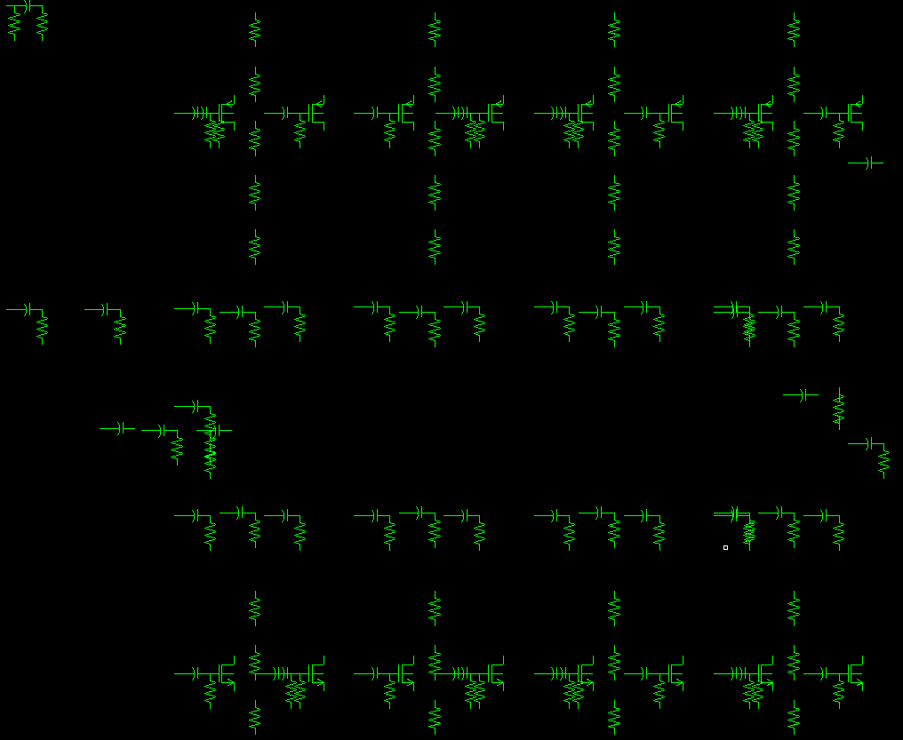
Layout: Tests
Design Rules Checking
(DRC) Compares to Standard Conventions
Layout Versus Schematic
(LVS) Compares Layout with Schematic
Layout Parameter Extraction
(LPE) Generates Parasitics for the Circuit
Figure 15: Parasitics Generated by LPE

Slide 18
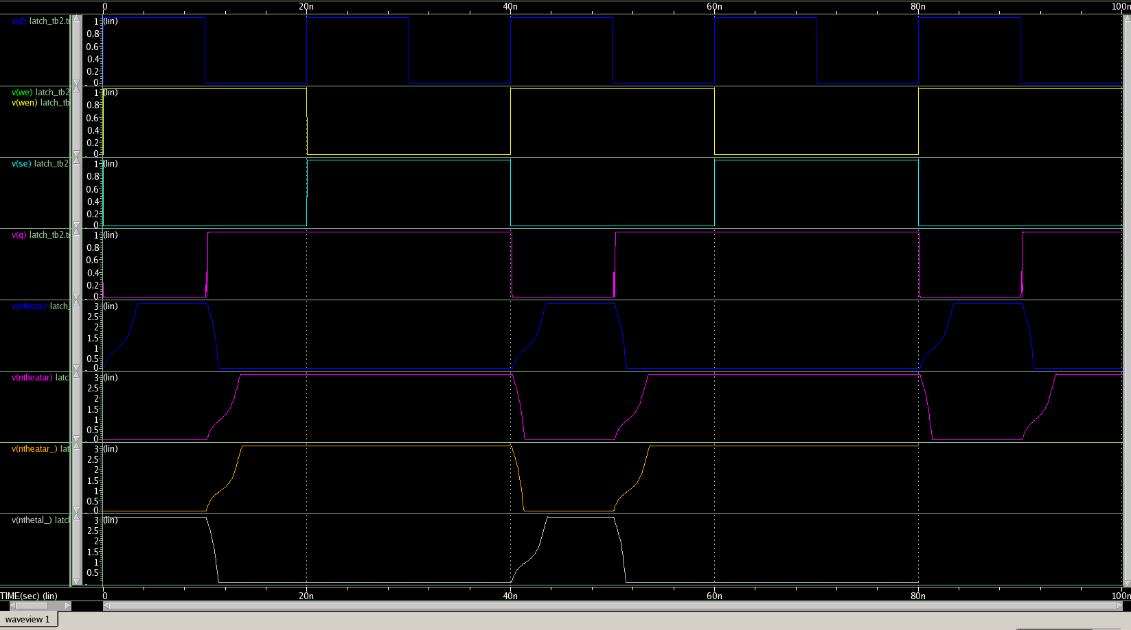
Post-Layout Testing
Inputted parasitics data into the hspice netlist of the full circuit
Ran the write path and read path of the full circuit with parasitics to measure new delays
Figure 16: Read Path Simulation with Parasitics
Full circuit also run in standby/idle mode to measure leakage power
Signals
Time (s)
Notes:
With the layout complete and layout parasitics generated by the LPE, we inputted all of this data back into the hspice netlist of the full circuit to run further tests on it. We ran the write path of the full circuit with parasitics to measure our new write delay. We then ran the read path of the circuit with parasitics to measure sensing delay and sensing power. Our sensing delay was measured as the time from when Sense Enable goes high to when Q and QB are updated. The full circuit was also run in standby/idle mode, which means no input signals were generated. This was done to measure the leakage power over one cycle.

Slide 19
Post-Layout Results
Write pass rate : 100%
Write delay : 3.5n
Write Power : 40.04 μW
Sensing pass rate : 100%
Sensing delay (from SE to Q/QB) : 168ps
Sensing Power (at SE frequency of 250 MHz) : 2.36 μW
Total Power: 42.4 μW
Leakage Power (standby or idle mode) : 1.5594μW
Total layout Area : 18.37μm²
Notes:
After the initial tests with the parasitics, we also ran a 1000 iteration monte carlo run to test the reliability of the circuit with parasitics. The newly introduced capacitance and resistance values of circuit components were not represented in the ideal simulations done previous to the layout and thus could have altered the reliability of our design. Sense enable frequency is determined by write delay (longest delay). Write power not essential to measure because write path would be used much less often than read in applications.

Slide 20
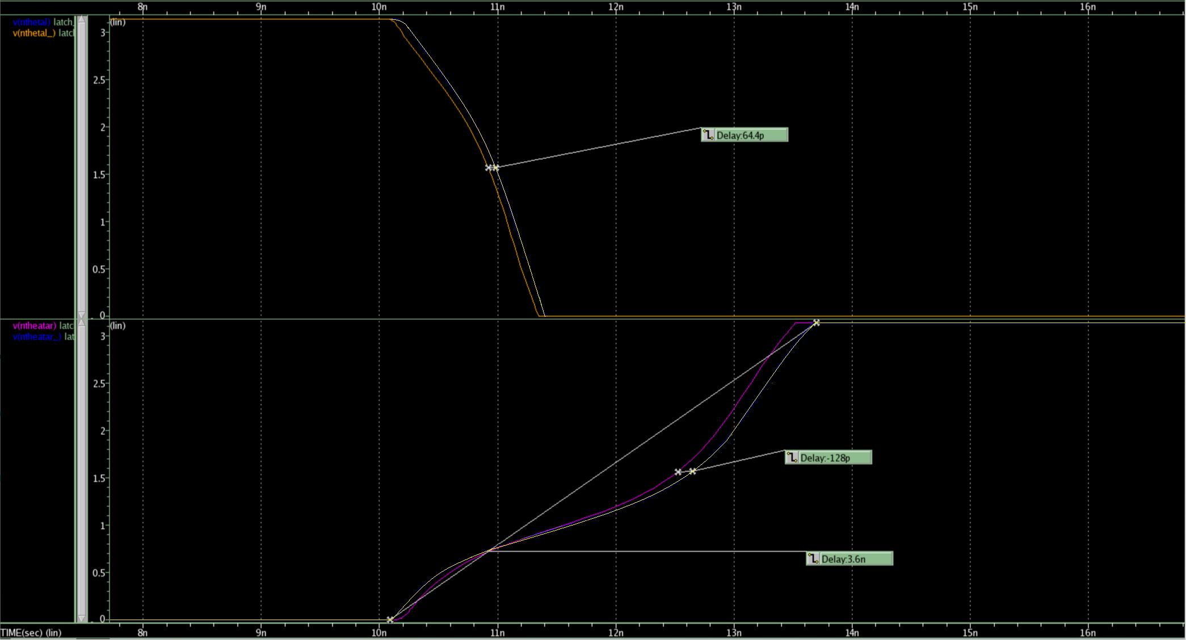



Pre-Layout vs Post-Layout
Write Path Delay Comparison
Figure 17: Write Path Simulation with Parasitics and without overlapped
MTJd theta (rad)
MTJr theta (rad)
Time (s)
Notes:
Delay increased by 128 ps. Not significant, no effect on reliability.

Slide 21
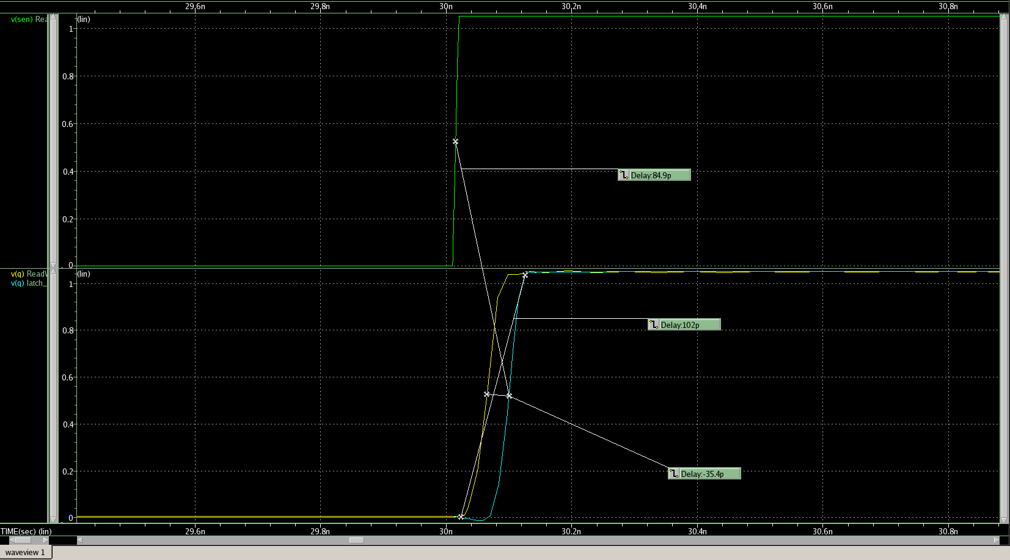



Pre-Layout vs Post-Layout
Read Path Delay Comparison
Figure 18: Read Path Simulation with Parasitics and without overlapped
SE
Q
Time (s)
Notes:
Our sensing delay is measured as the time from when Sense Enable goes high to when Q and QB are updated.
Due to the delay in the read cycle being in the picosecond range, changes in delay did not result in significant changes in failure rate. This explains why the reliability of the circuit remained at 100% despite the multifold increase in Read path delay. Original 3ps. Now 113 ps.

Slide 22
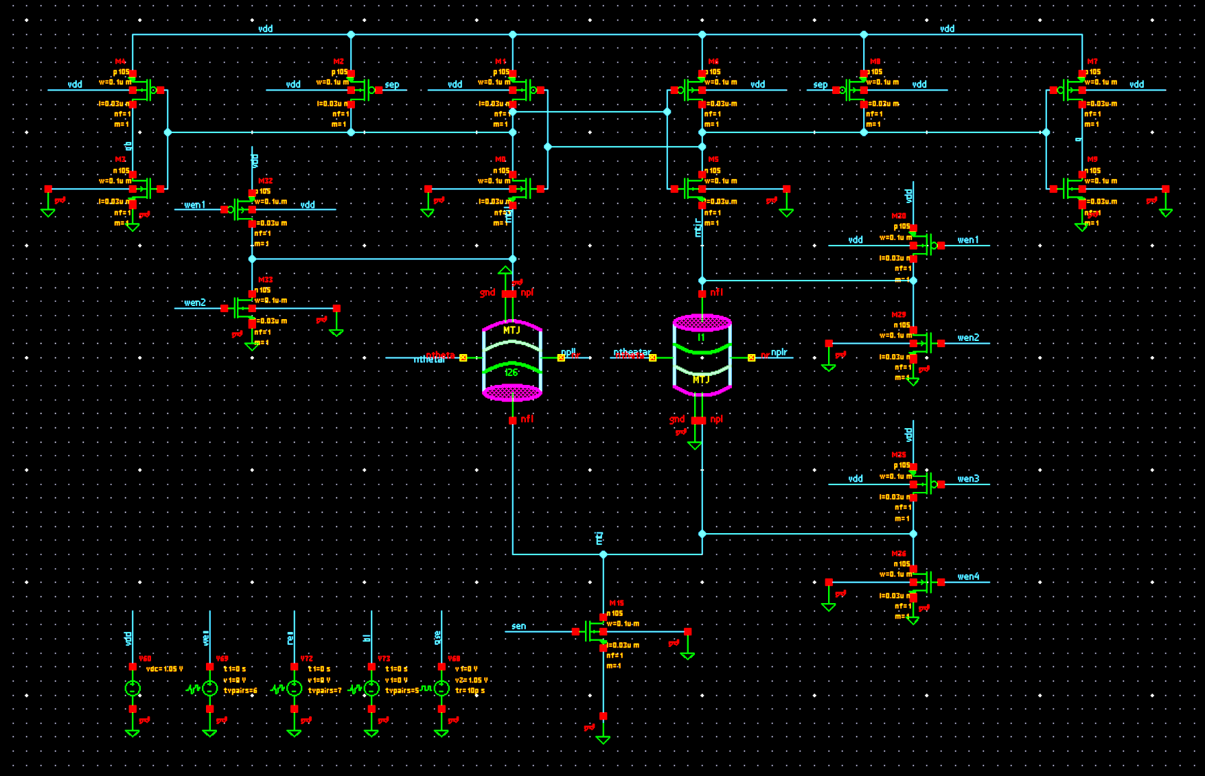
Conclusion
Low delay corresponded with low failure rate and thus high reliability.
High area and high power consumption corresponded with low failure rate. However, higher area and higher power imply higher cost so there was a tradeoff in the optimization.
Larger increases in width were needed in the write path than the read path for similar improvements in reliability.
Focus of future research on this subject will be on the improvement of the layout design to minimize area.
Notes:
The purpose of this research was to optimize the design of a non-volatile (NV) Precharge Latch and to use the data from the optimization to show the correlation between delay and failure rate. The write operation was much larger than the Read operation and less sensitive, requiring a large write current. The best transistor values for the write circuit were 1.871, 2.402, 3.702, and 3.001 micrometers for topN, topP, sinkP, and sinkN respectively. The highest delay for the circuit at these values was 2.9999 nanoseconds. The methodology for optimizing the Read operation was similar to the Write operation. The optimal transistor widths for the Read operation were 1.3, 1.5, 1.5, and 0.1 micrometers for WN1, WN2, WP1, and WP2 respectively. The delay for the Read operations was 3.755 picoseconds. This is evidenced by the extremely low delay of the optimized Read operation compared to the optimized delay of the Write operation. Due to the delay in the read cycle being in the picosecond range, changes in delay did not result in significant changes in failure rate. This explains why the reliability of the circuit remained at 100% despite the multifold increase in Read path delay. Power consumption was decided to not be an important metric of optimization for us because the device was already theoretically extremely power efficient. Furthermore, in our final tests of the optimized circuit with parasitics, we recorded a power leakage of only 1.5594 microWatts and a read path power consumption of only 42.4009 microWatts. This power leakage is less than leading active power consumption memory technologies.

Slide 23
Acknowledgments
Thank you to Dr. Hamid Mahmoodi, Ali Attaran, and Tyler Sheaves for mentoring us in this project with technical, aesthetic, and presentation guidance. Thank you to Synopsys for providing EDA licenses to NECRL and to DARPA for continued funding for this research. We are very grateful for this opportunity brought to us by Dr. Amelito Enriquez and the ASPIRES program.

Slide 24
References
[1] H. Mahmoodi, A. Attaran, T. Sheaves, “Design of a Non-Volatile Latch using Resistive Memory Technology” [2] H. Mahmoodi, S. Srinivasan Lakshmipuramᐩ, M. Aora, Y. Asgarieh, H. Homayoun, B. Lin and D. M. Tullsen “Resisitive Computation: A Critique.” IEEE COMPUTER ARCHITECTURE LETTERS, VOL. 13 NO.2, JULY-DECEMBER 2014 [3] W. Zhao, E. Belhaire and C. Chappert “Spin-MTJ based Non-Volatile Flip-Flop.” Proceedings of the 7th IEEE International Conference on Nanotechnology August 2-5 2007, Hong Kong [4]Wicht, Bernhard, Thomas Nirschl, and Doris Schmitt-Landsiedel. "Yield and Speed Optimization of a Latch-Type Voltage Sense Amplifier." IEEE JOURNAL OF SOLID-STATE CIRCUITS , VOL.39 NO.07, JULY 2004 [5]Welser, Jeffrey, S.A. Wolf, and Phaedon Avouris. " 282 CHAPTER 8 APPLICATIONS: NANOELECTRONICS AND NANOMAGNETICS ." Nanotechnology Research Directions for Societal Needs in 2020. London: Springer Dordrecht, 2011.

Slide 25


Slide 26


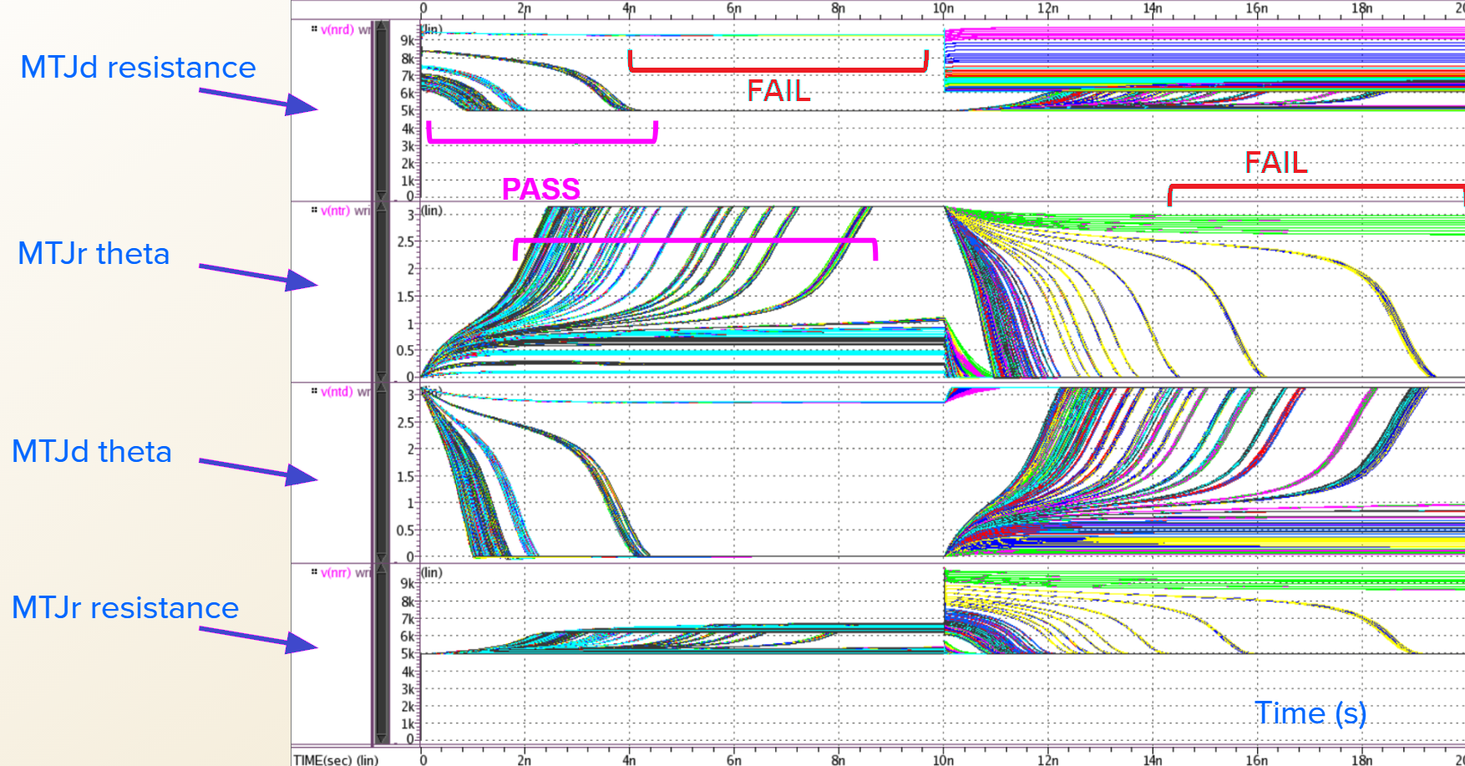
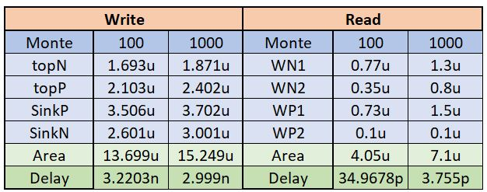
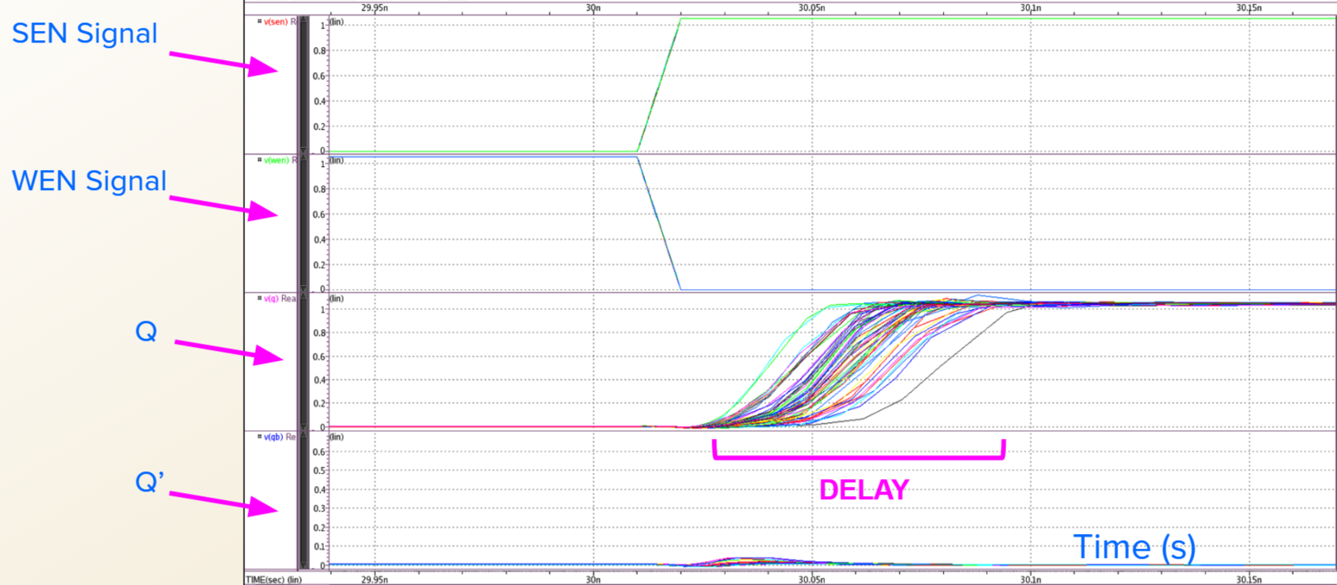
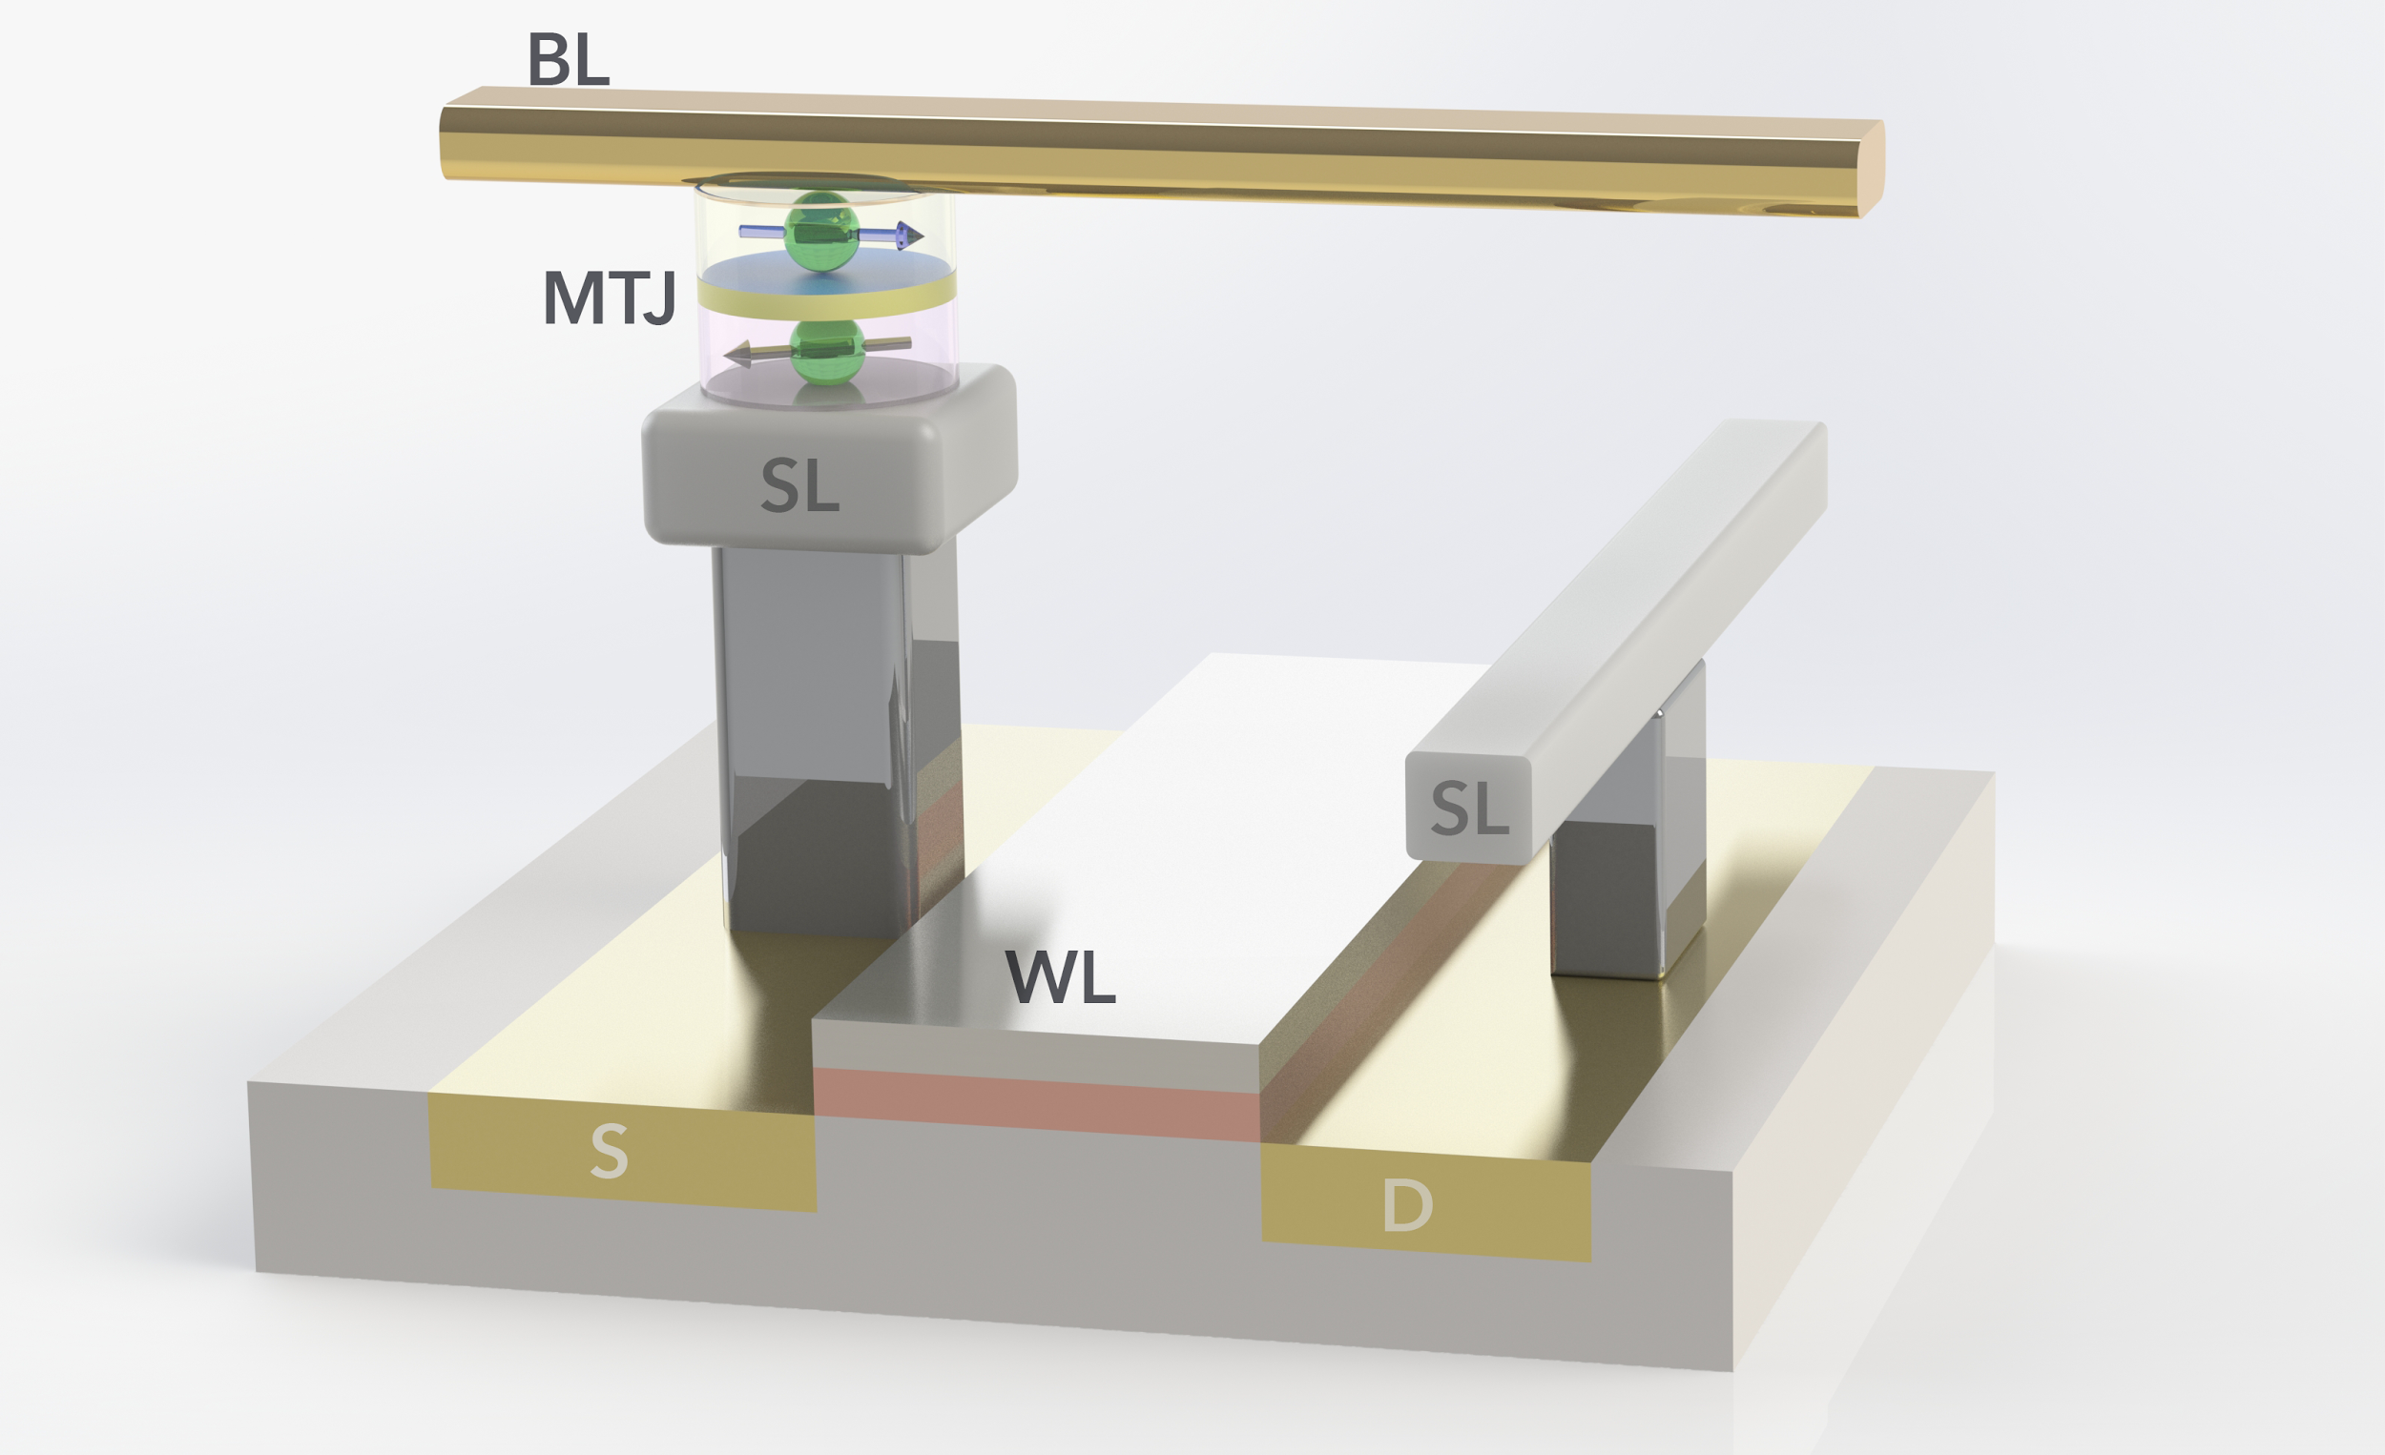
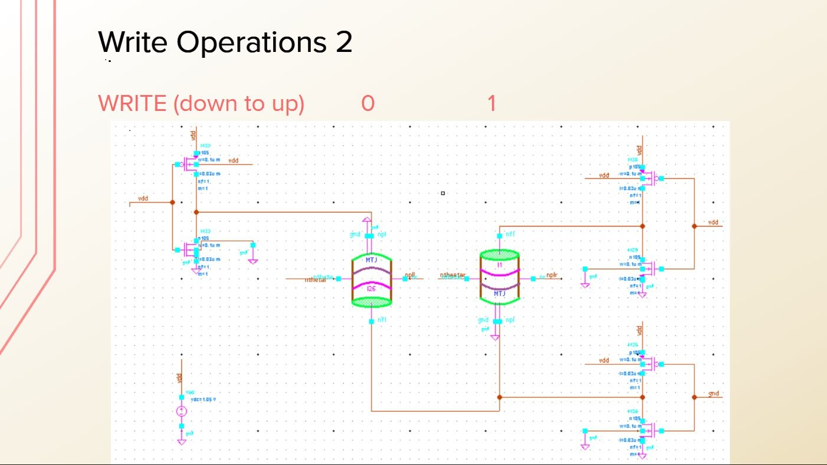
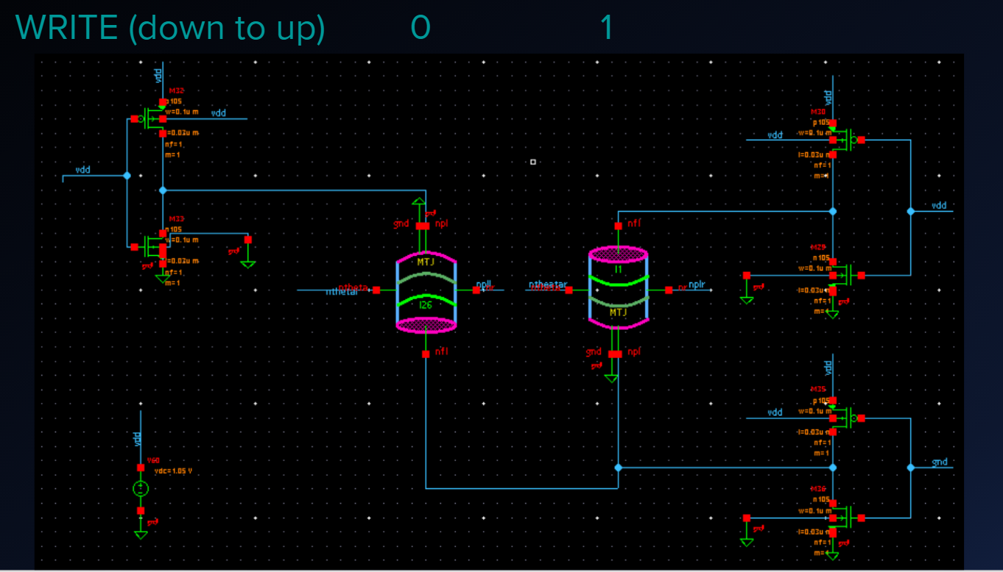
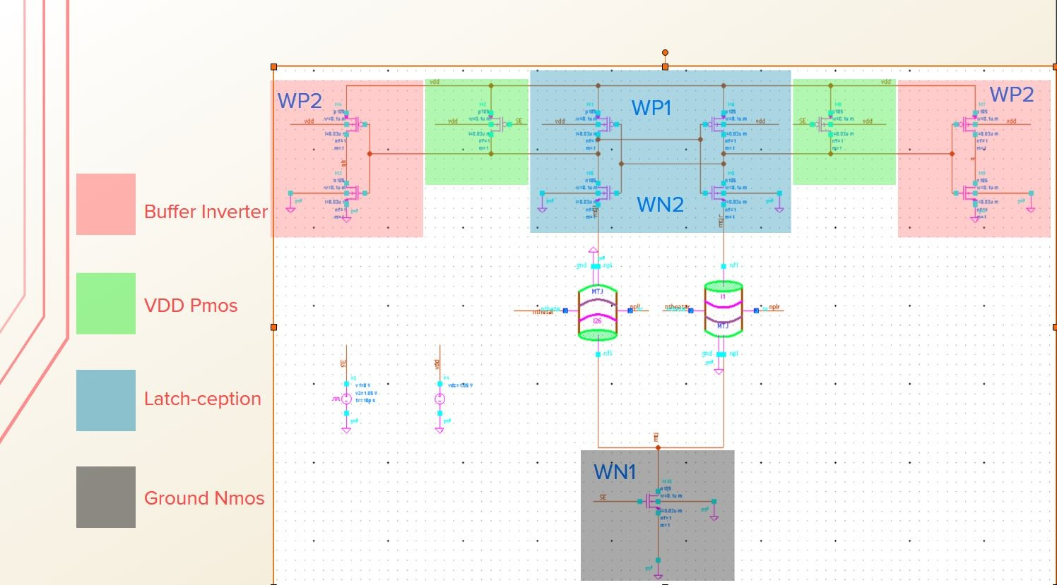
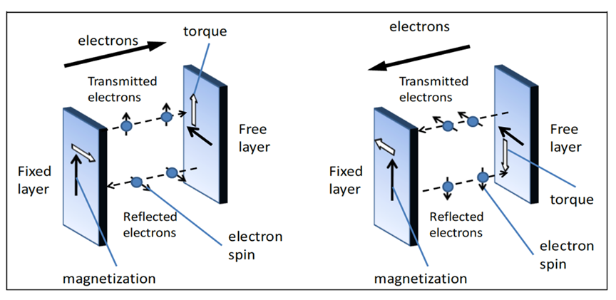
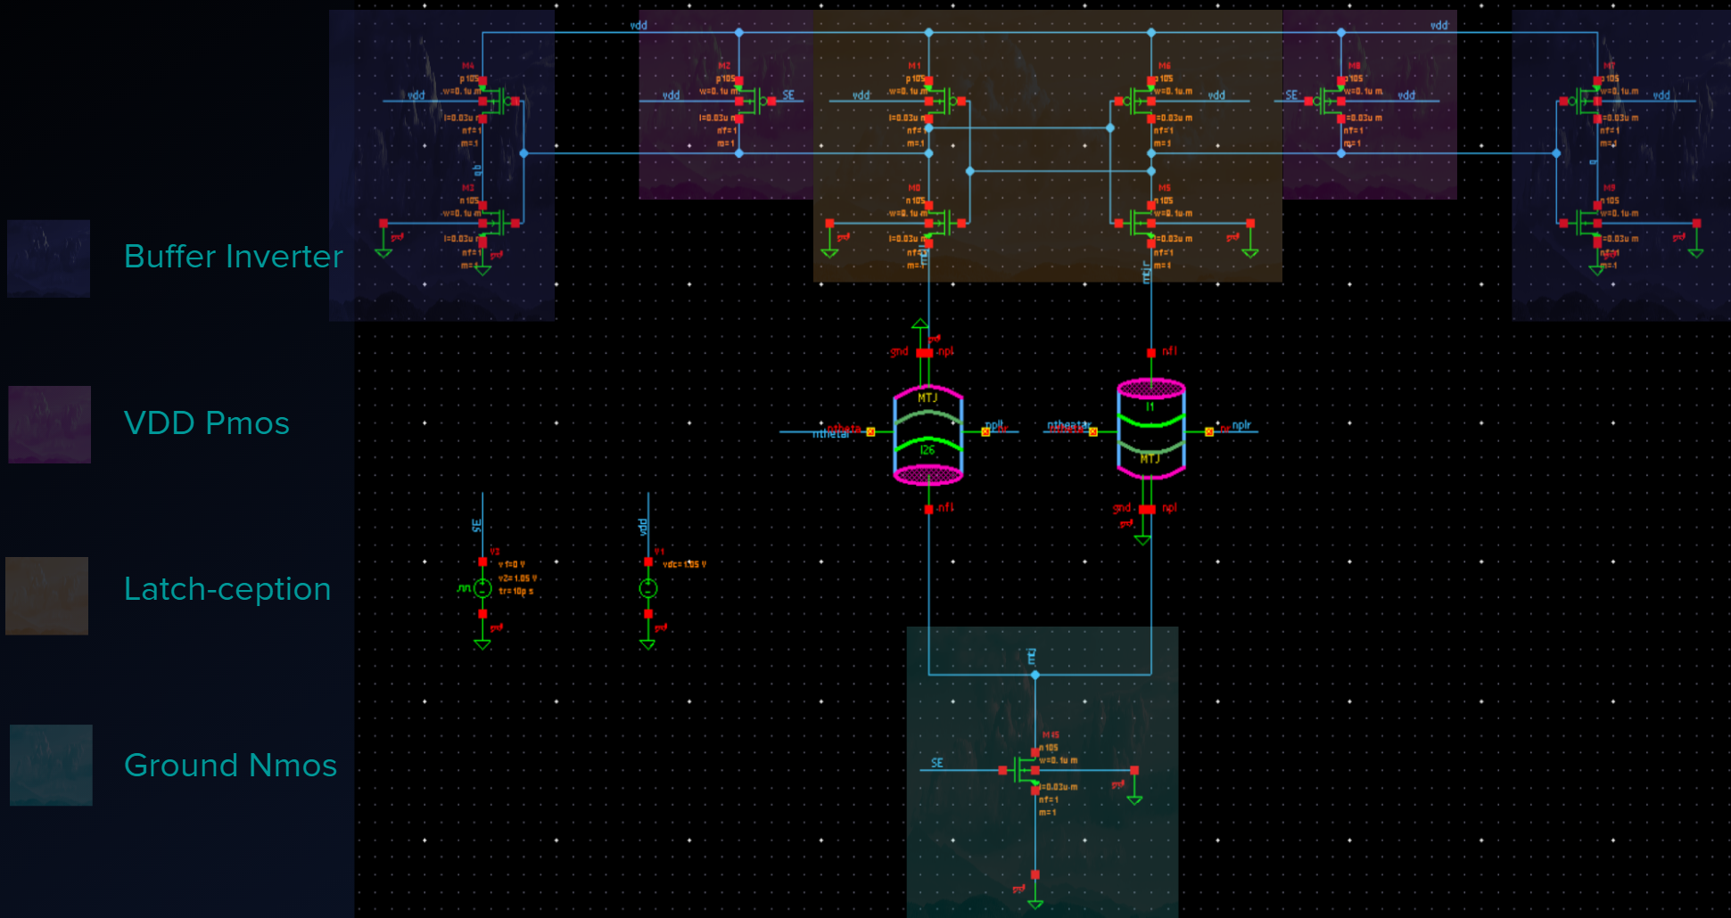
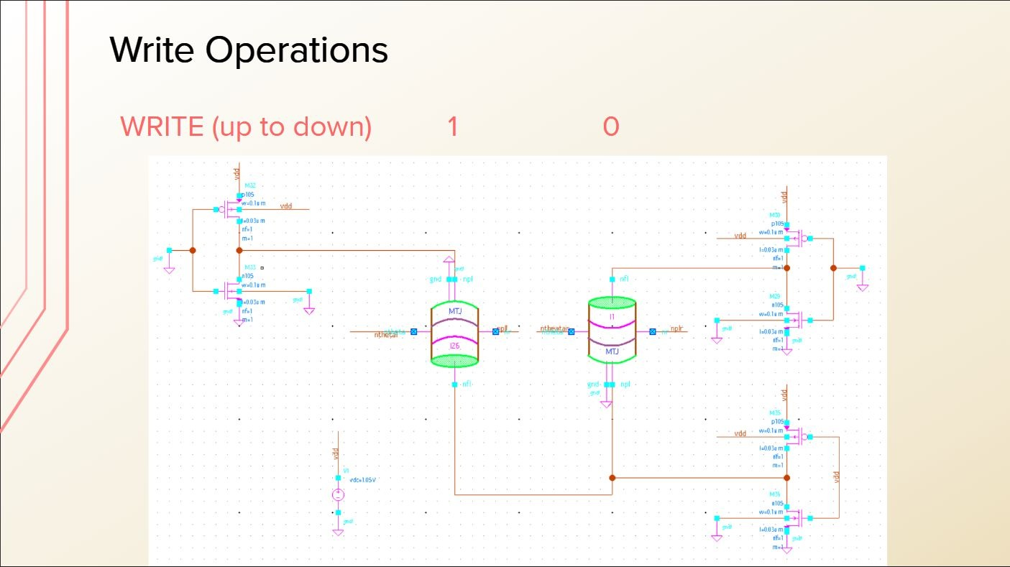
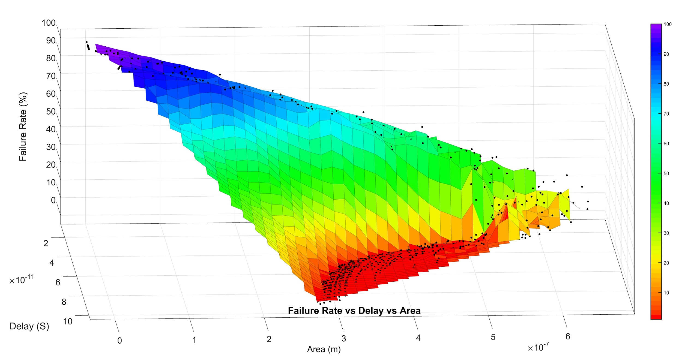
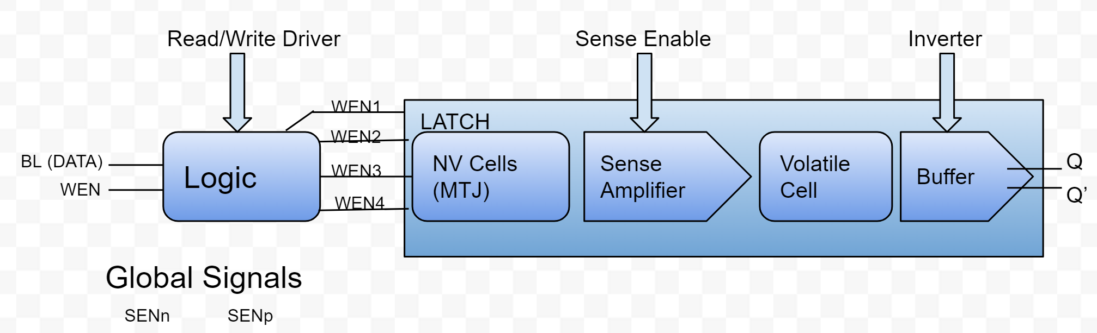
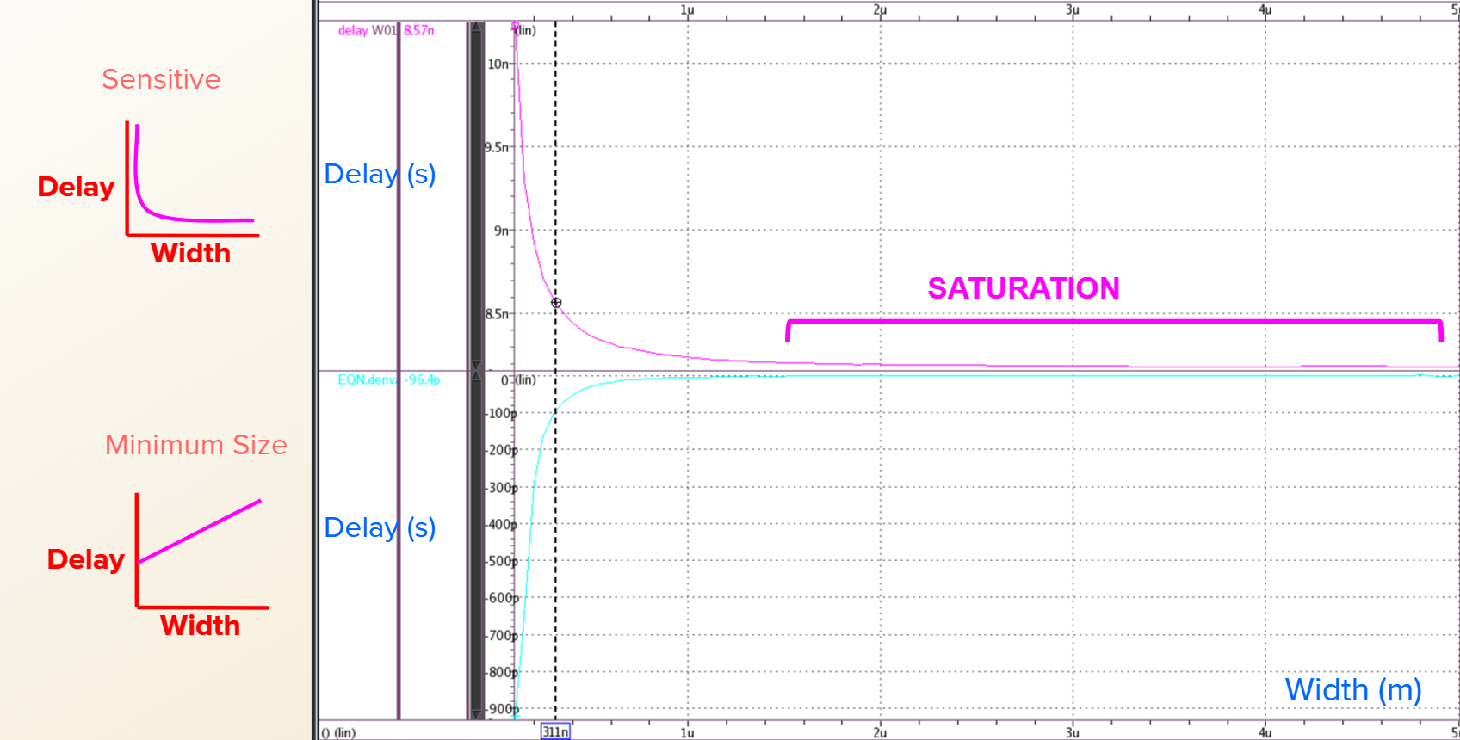
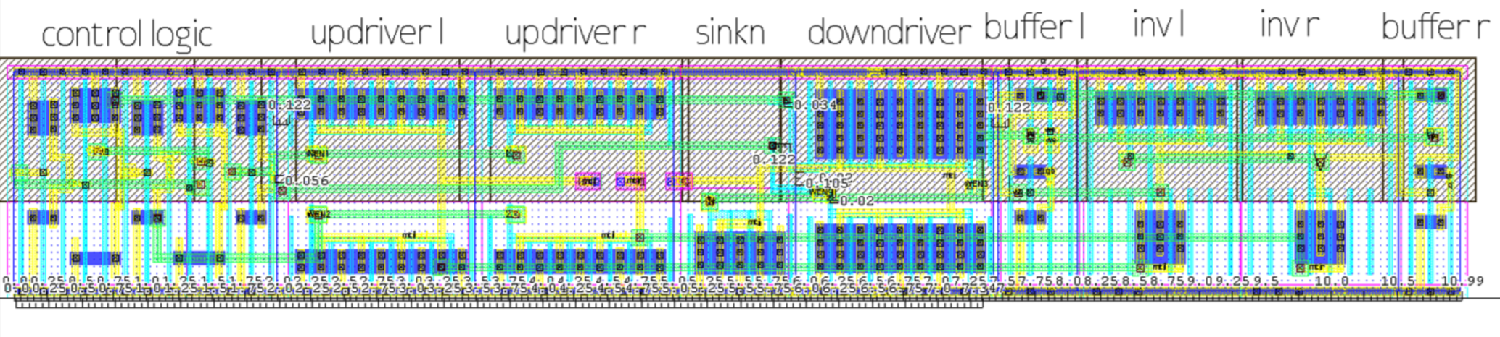
Design and Optimization of Non-Volatile Latch using Resistive Memory Technology
Vladislav Miftakhov¹, Cody Del Prato¹, Søren Tornøe¹, Kwan Lim¹
Graduate Mentor: Aliyar Attaran², Advisor: Hamid Mahmoodi²
¹Cañada College 4200 Farm Hill Blvd. Redwood City, CA 94061
²San Francisco State University: Dept. of Engineering 1600 Holloway Ave. San Francisco, CA 94132
1. Introduction
Logic
Optimization of write (6 Transistors)
6. Results
Modern Semiconductor industry is vulnerable to IP fraud and reverse engineering due to low hardware security and IC fabrication foundries outsourcing semiconductor design.
The control logic is composed of two inverters and two nand gates, and it generates the signals to flip the MTJ.
Depending on the direction of the current, values (either 0 or 1) are introduced for the Data and the Write Enable (1-4).
We ran multivariable simulations with four variables to see how the transistor values are affected and to find accurate width values.
Bit-Line (Data) | Wen | WEN1 | WEN2 | WEN3 | WEN4
0 | 0 | 1 | 0 | 1 | 0
0 | 1 | 1 | 1 | 0 | 0
1 | 0 | 1 | 0 | 1 | 0
1 | 1 | 0 | 0 | 1 | 1
STT technology poses as a great potential solution. It can be used to improve hardware security by implementing fast, reconfigurable logic to IC design.
Write Cycle Transistor sizes; topN was 1.871μm, topP was 2.402μm, SinkP was 3.506μm, and SinkN was 3.001μm
Read Cycle Transistor sizes; WN1 was 1.3μm, WN2 was 0.8μm, WP1 was 1.5μm, and WP2 was 0.1μm
Post Layout write path was rerun with parasitics and results showed the unideal delay of 3.5ns
Post Layout Read Path with parasitics had a delay of 168ps with sensing power of 42.4009 μW. Leakage Power was very low at 1.5594μW at SE frequency of 250 MHz
Post-Layout 1000 iteration Monte Carlo run with parasitics yielded 100% pass rate for both Write and Read Operations
Optimization of read (12 Transistors)
Optimization of the read cycle was performed by using HSpice and a netlist that allowed delay and area to be used as weighted goals.
2. Spin Transfer Torque Random Access Memory (STTRAM)
Write and Read Operations
Write Operations
When writing a 0 1 to the pair of MTJs, WEN1 and WEN2 are low, the top NMOS transistors are on, and the top of the circuit is connected to ground while WEN3 allows the bottom PMOS to turn on.
When writing 1 0 to the pair of MTJs, WEN1 and WEN2 are high which allows VDD to be present at the top of the circuit.
Read Operations
During the pre-charge phase sense enable is low and the PMOS at the top of the circuit allows the circuit to be pre-charged with VDD while the NMOS that connects to ground is not active.
During the evaluation phase sense enable is high and the VDD PMOS is inactive while the Grounding NMOS is active and allows the circuit to connect to ground.
The netlist contained a parameter which allowed an area goal to be set so that HSpice would determine the best possible transistor size.
Resistive memory technology to replace traditional charge-based memory.
Information storage by use of magnetic orientation.
CMOS compatibility, scalability, non-volatility,
low power
Monte Carlo Simulations
A Monte Carlo failure rate netlist program was used to test each set of values recorded in the optimization process.
Each set of our values was run at 1000 iterations to ensure reliability of the circuit to within 0.1% accuracy.
We looked for values that passed simulations with 0% failure rate, which meant a minimum of 99.9% reliability.
The optimization for 100 run Monte Carlo yielded best values that had higher delay, lower reliability, and lower area.
3. Magnetic Tunnel Junction (MTJ)
7. Conclusion
Low delay corresponded with low failure rate and thus high reliability
High area and high power consumption corresponded with low failure rate
Optimized values of the read path transistors much smaller than those of the write path. Larger increases in width were needed in the write path than the read path for similar improvements in reliability.
Focus of future research on this subject will be on the improvement of the write path in terms of area, power consumption, and delay
Composed of an oxide layer in between two ferromagnetic layers; one free and one pinned.
Used to store information
as binary bit.
Resistance is sensed by
applying a current to
MTJs layers.
Information is sensed
as resistances.
Low resistance is logic state 0 & High resistance is logic state 1.
8. References
[1] H. Mahmoodi, A. Attaran, T. Sheaves, “Design of a Non-Volatile Latch using Resistive Memory Technology”
[2] H. Mahmoodi, S. Srinivasan Lakshmipuramᐩ, M. Aora, Y. Asgarieh, H. Homayoun, B. Lin and D. M. Tullsen “Resisitive Computation: A Critique.” IEEE COMPUTER ARCHITECTURE LETTERS, VOL. 13 NO.2, JULY-DECEMBER 2014
[3] W. Zhao, E. Belhaire and C. Chappert “Spin-MTJ based Non-Volatile Flip-Flop.”
Proceedings of the 7th IEEE International Conference on Nanotechnology August 2-5
2007, Hong Kong
[4]Wicht, Bernhard, Thomas Nirschl, and Doris Schmitt-Landsiedel. "Yield and Speed Optimization of a Latch-Type Voltage Sense Amplifier." IEEE JOURNAL OF SOLID-STATE CIRCUITS , VOL.39 NO.07, JULY 2004
[5]Welser, Jeffrey, S.A. Wolf, and Phaedon Avouris. " 282 CHAPTER 8 APPLICATIONS: NANOELECTRONICS AND NANOMAGNETICS ." Nanotechnology Research Directions for Societal Needs in 2020. London: Springer Dordrecht, 2011.
4. Design and Parameters
5. Methodology
The precharge latch consists of two MTJs as resistive memory cells to hold our data as binary one or zero.
The outputs are the voltage out referenced as Q for the left side of the circuit and Q’ for the right side of the circuit. There are four inputs for the write; WEN1, WEN2, WEN3, and WEN4.
Delay Vs Width Sweeps
Circuit first created as a schematic and exported as HSPICE netlist.
Added lines of code to Netlist to measure delay, area, and MTJ orientation.
Using the netlist, simulations were run of the full circuit where individual transistor widths were adjusted.
The change in delay due to the changes in transistor widths was then measured for both the Write and Read circuits.
Layout
The goal of the layout was to minimize the area the circuit would take up while still being able to perform as desired.
The first test we ran once our layout was constructed was the Design Rules Checking (DRC), which checks to make sure our design follows the current rules and conventions used in manufacturing.
All of the nmos and pmos layers must overlap each other and the VDD and VSS must all be formed into one bar across all instances respectively to create one continuous circuit.
9. Acknowledgements
Thank you to Dr. Hamid Mahmoodi and Ali Attaran for mentoring us in this project with technical, aesthetic, and presentation guidance. Thank you to Synopsys for providing EDA licenses to NECRL and to DARPA for continued funding for this research. We are very grateful for this opportunity brought to us by Dr. Amelito Enriquez and the ASPIRES program.
Notes:
ile

